Slide 1
Liquid Propulsion week 3 report

Slide 2
Tasks accomplished this week
Setting up of the solid motor rocket ignition circuit
Literature review of the previous liquid group’s reports
Calibration of the load cell for the static test
Debugging and testing of the liquid ignition system
Purchase of electronic components and microcontrollers
Fix the spark plug circuitry

Slide 3
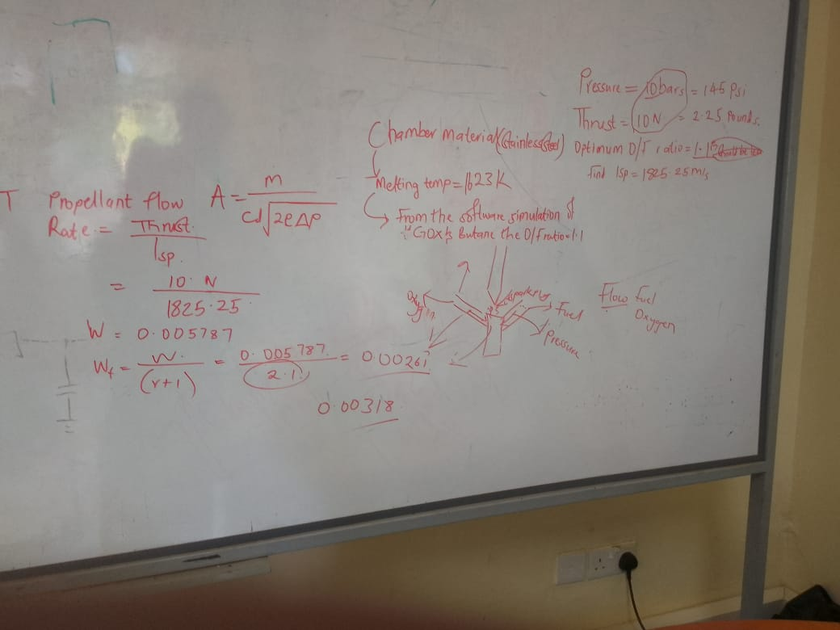
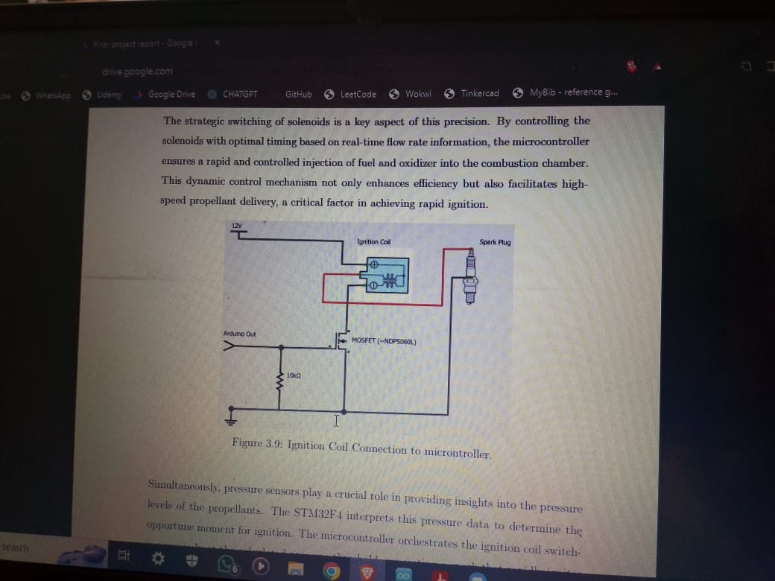
Review of the previous liquid team’s literature

Slide 4
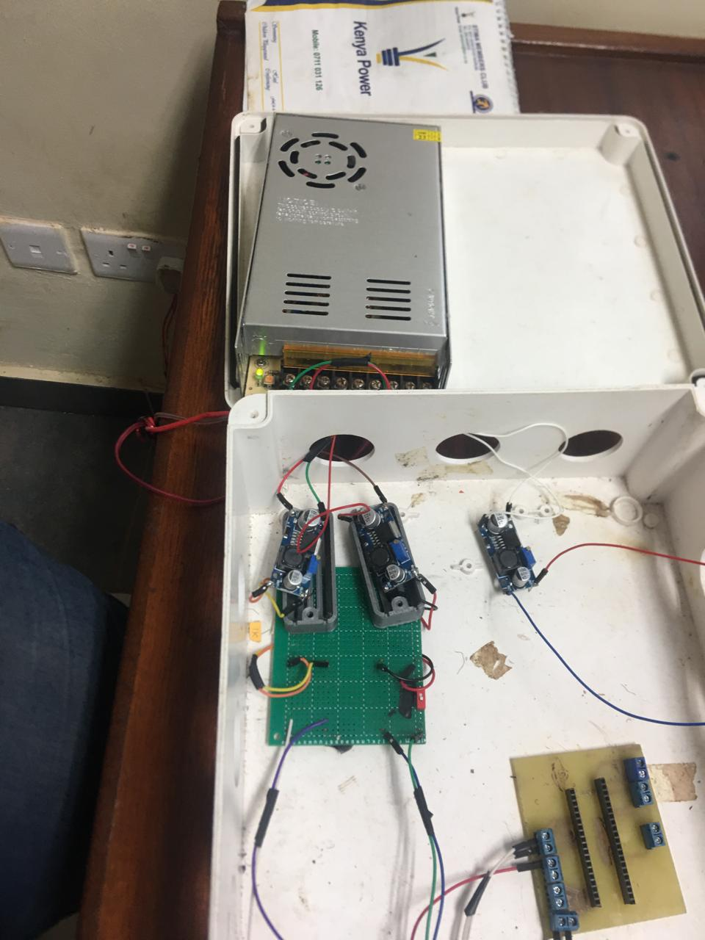
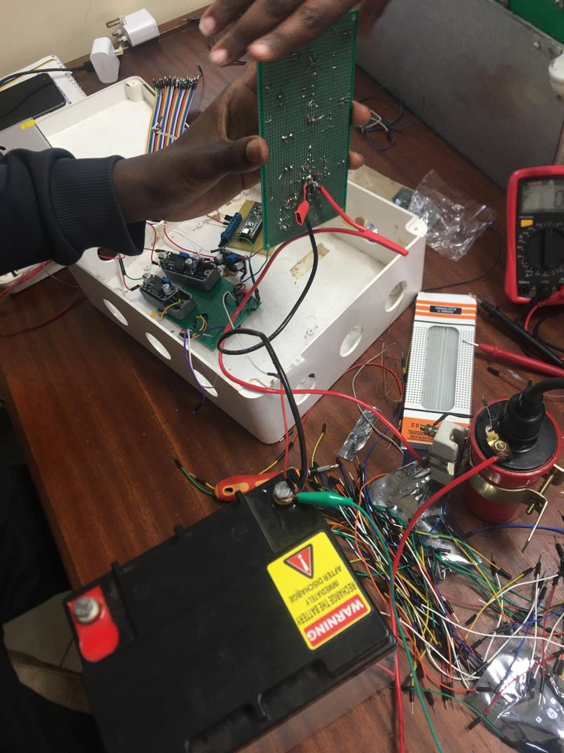
#31: Debugging of the liquid ignition circuit

Slide 5
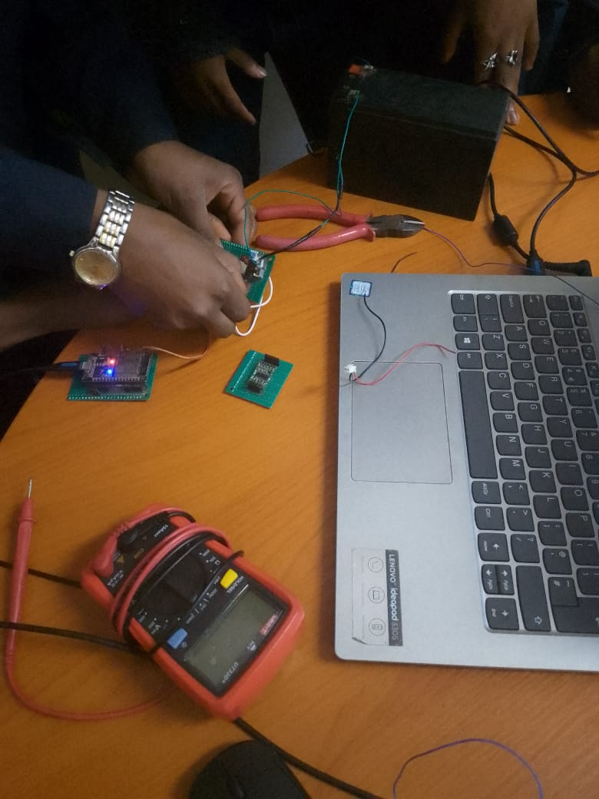
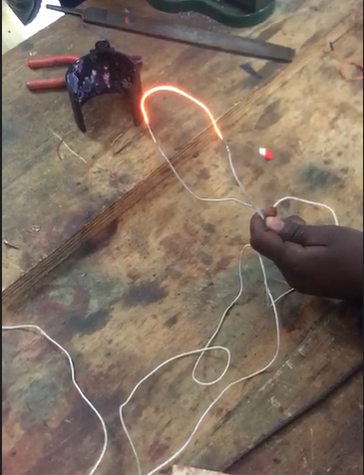
#17: setting up the Solid motor igniter circuit

Slide 6
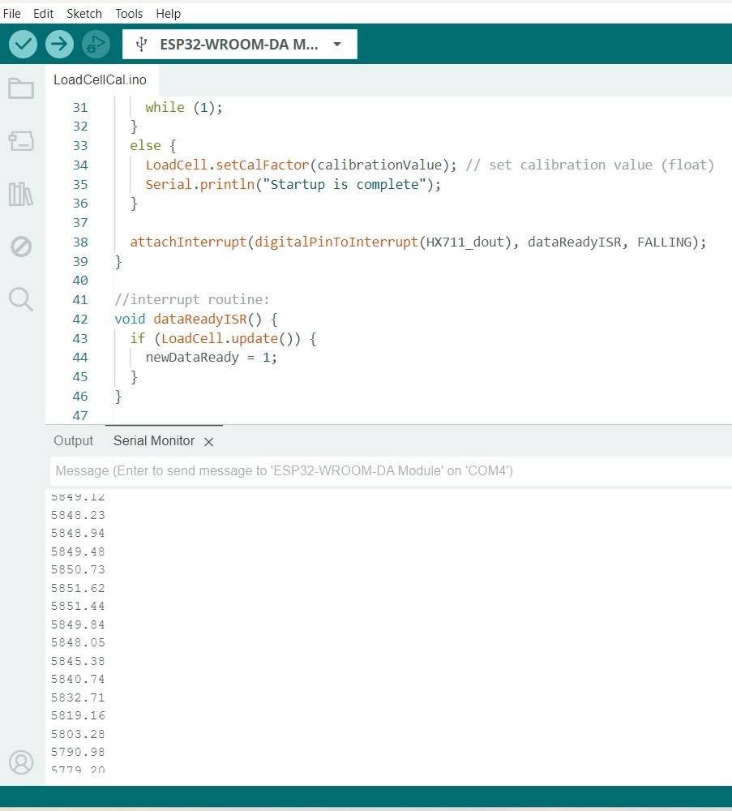
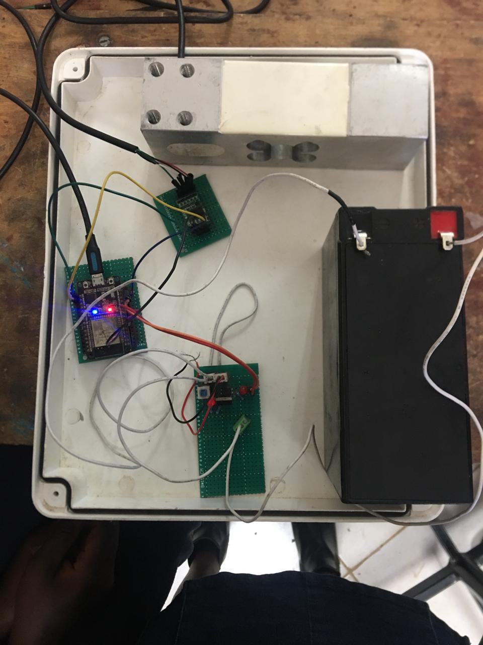
#32: Calibration of load cell

Slide 7
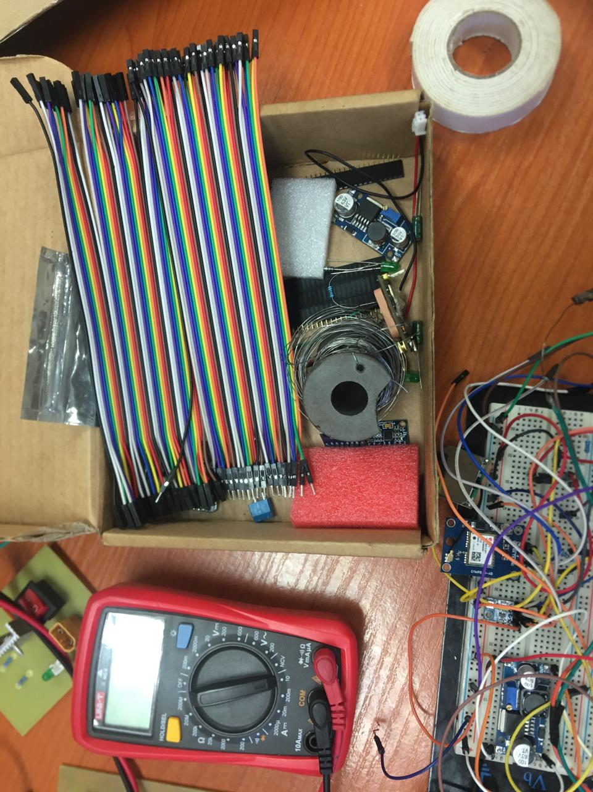
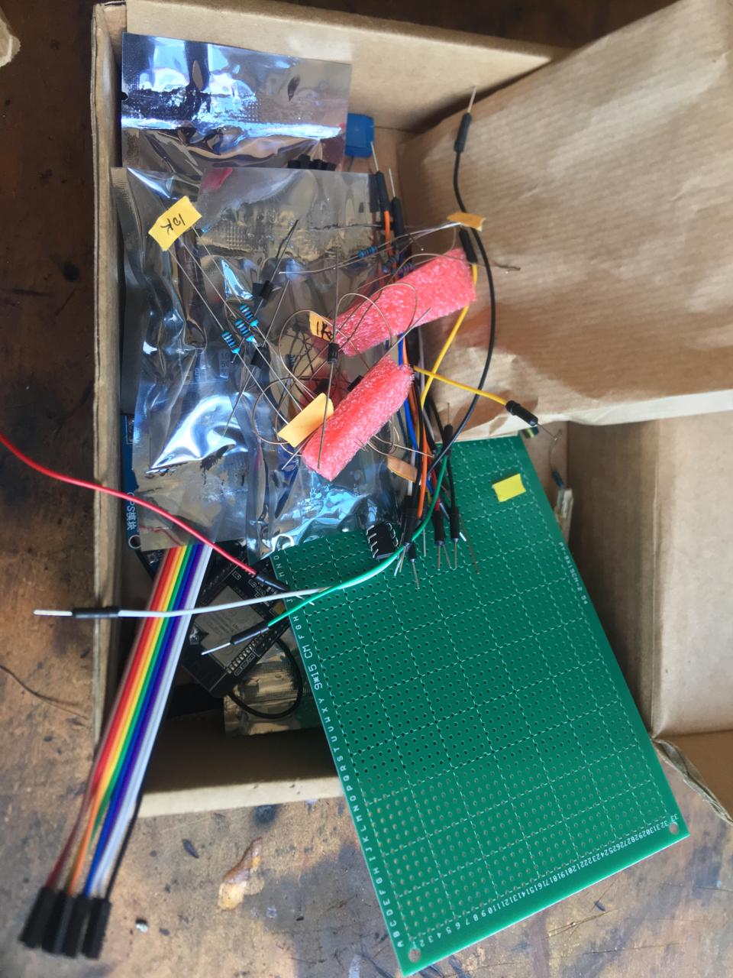
Purchasing of components

Slide 8
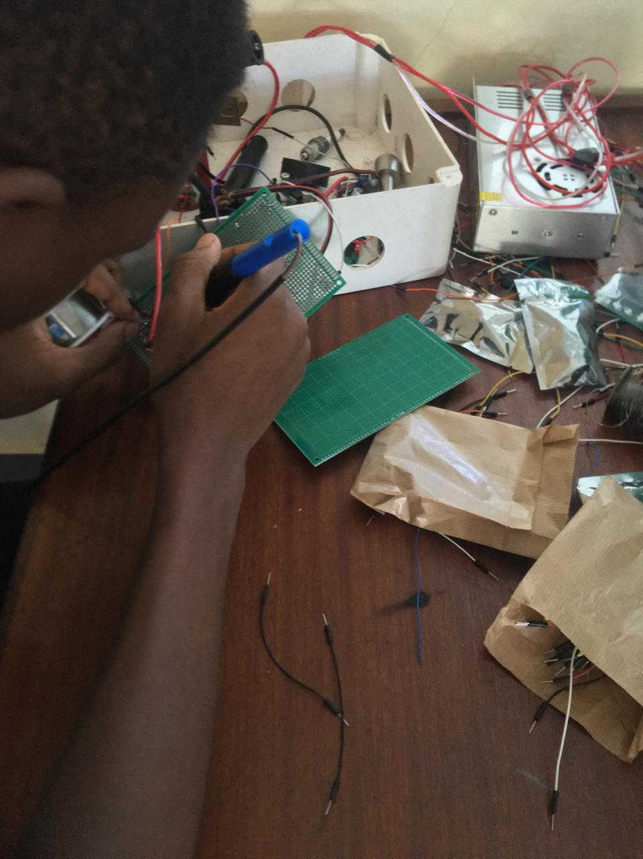
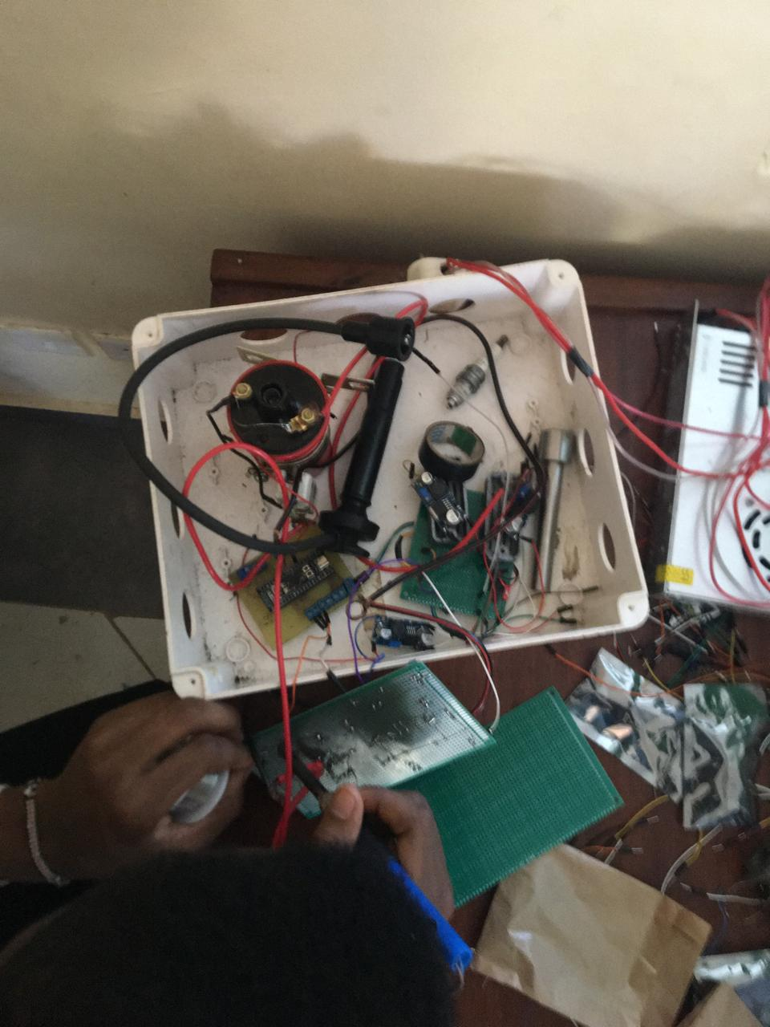
#36: Replacing & Soldering of damaged components on the proto board

Slide 9
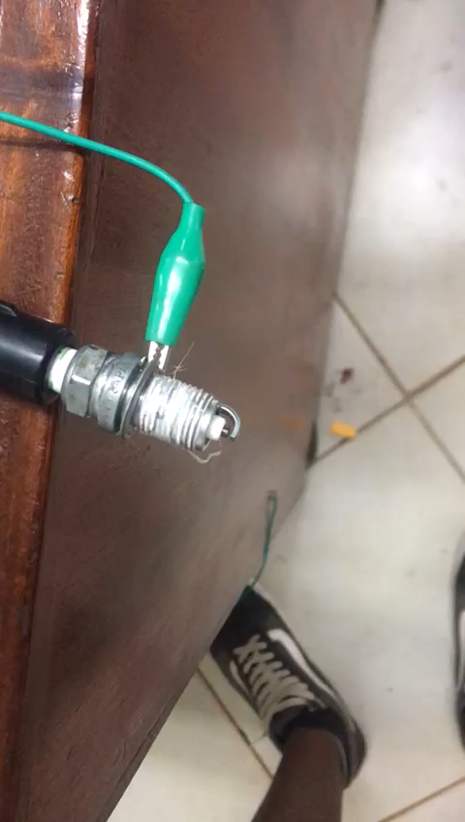
Testing of the spark plug
The ignition coil power issue was fixed

Slide 10
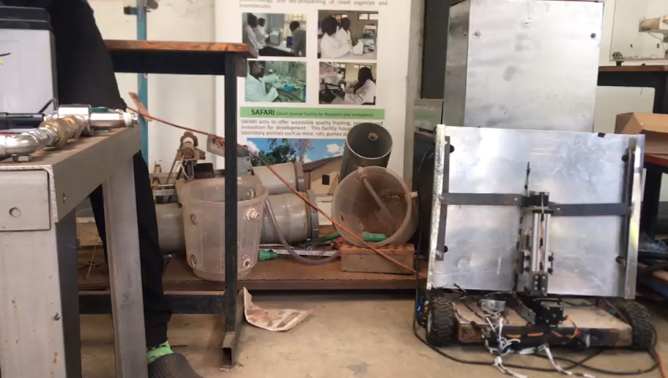
Testing of the entire liquid ignition circuit
The spark plug work successfully with the solenoid valves to ignite a flame.

Slide 11
Tasks to be done next week
Design of a PCB for the liquid ignition circuit
Familiarize ourselves with the combustion simulation software e.g. CEA, RPA, etc.
Integrate pressure sensors and flowmeters into the current liquid ignition circuit
Assist the solid team to add temperature and pressure sensors into their igniter system
Understand the P&ID diagrams for the liquid plumbing system

Slide 12
Thank you

